Slide 1
Project Start Date, Housing Move-in Date, and Date of Engagement
MD Bos HMIS Monthly refresher training: January 2025

Slide 2
Project Start Date
Why is this Data Element important?
Determines the beginning of client participation in a project
Every project requires this data element to report the time a specific client spends participating in the project.
Paired with 3.20 ‘Housing Move-In Date,” it becomes possible to determine the length of time from project start to housing placement for all clients accessing permanent housing.

Slide 3


Project Start Date
Data Collection Requirements
Who?
Needs to be collected for All Clients entering all HMIS Project Types.
When?
Needs to be collected for All Clients entering all HMIS Project Types at the Project Start.

Slide 4
Project Start Date
Households
Each individual client in a Household(HH) will have their own 'Project Start Date'.
If a New HH member is entered into a Project after other HH Members, they will have a different 'Project Start Date'.
Newborns will have a 'Project Start Date' that reflects the date the project started providing services to the newborn.

Slide 5
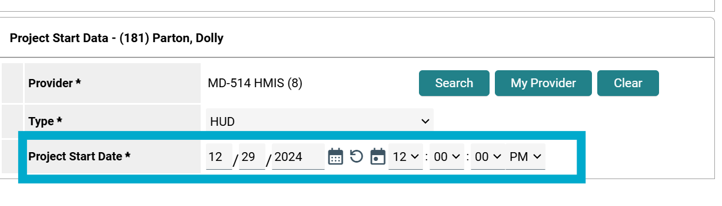
Project Start Date
Project Start Date in Community Services (HMIS)
Record the month, day and year of each client's project start.
The 'Project Start Date' indicates a client is now being assisted by the project type.
For each client's enrollment in a project, there must be one 'Project Start Date.'

Slide 6
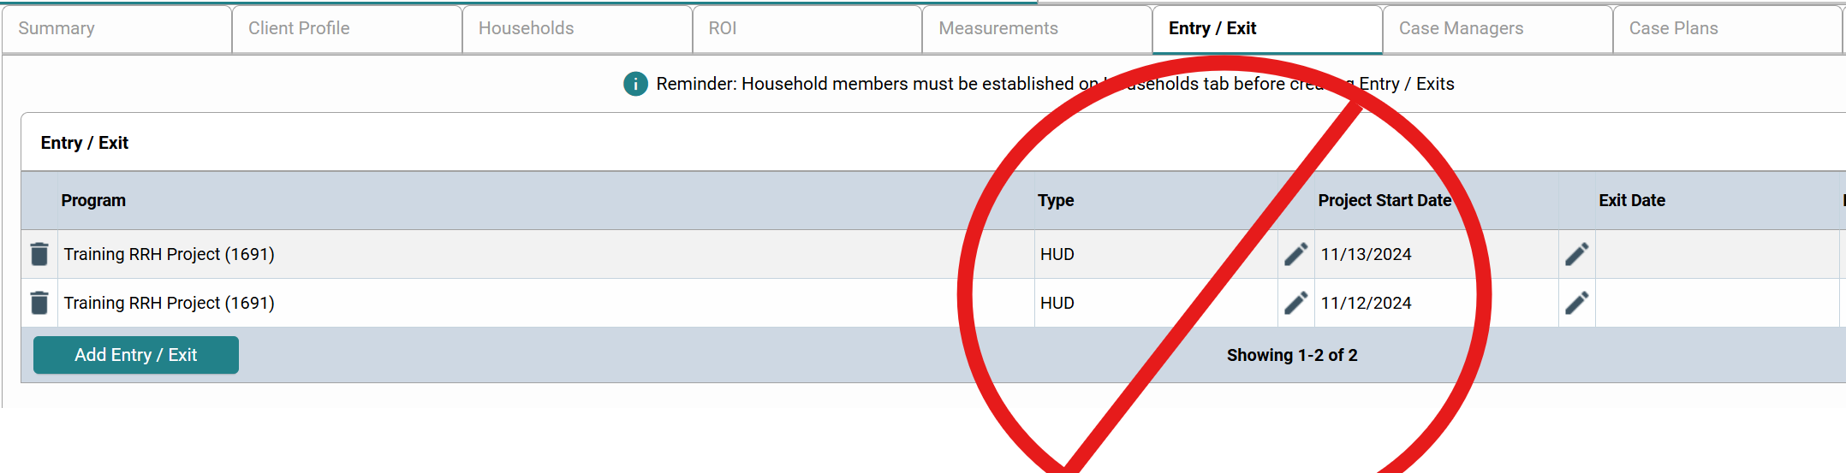
Project Start Date
Project Start Date in Community Services (HMIS)
For each client's enrollment in a project, there must only be one 'Project Start Date'.
Any data entry errors should be corrected ASAP!

Slide 7
Project Start Date
Different for each Project Type
Different project types use 'Project Start Date' differently, to address the difference in meaning associated with "starting" residential, service, and permanent housing projects.

Slide 8
Project Start Date
Different for each Project Type
Street Outreach: Date of first contact with Client
Emergency Shelter: The night the client first stayed in the shelter.
Safe Haven and Transitional Housing: First night in Residence.
Permanent Housing: Date the client was admitted into the project.
Other Projects (Including but not limited to: Services Only, Day Shelter, Homelessness Prevention, Coordinated Entry): Date the client first began working with the project and generally received the first provision of service.

Slide 9
Project Start Date
Things to remember for PIT/HIC
'Project Start Date' needs to be on or before 1/22 for clients to be included in the 2025 PIT and HIC counts.

Slide 10
Housing Move-in Date
What is the Housing Move-in Date
Documents the date that a Household (HH) or Individual enrolled in a permanent housing project moves into housing.
Must be entered if/when a HH moves into any type of permanent housing, to differentiate between clients who are housed and those who are experiencing homelessness at different points during their enrollment.

Slide 11
Housing Move-in Date
Why is this Important?
The HMID is used to identify whether or not a client is permanently housed by referring to the date the client physically moved into housing.
Since reducing the number of people in homelessness is central to why we collect data, the HMID is critical in order to signal a change between unhoused and housed.
Incorrectly recording this data element will result in errors and/or inaccurate data on the various reports throughout the CoC

Slide 12
Housing Move-in Date
Why is the HMID Important for the PIT/ HIC?
This date is critical to HIC and PIT counts as it differentiates whether HH's enrolled in permanent housing projects are housed or unhoused.
For purposes of the HIC and PIT reporting, HH's or Individual's enrolled in permanent housing projects with a 'Project Start Date', but do not have a 'Housing Move-In Date' at the point in time of the report must be excluded from counts of persons in permanent housing.

Slide 13
Housing Move-in Date
What is HUD's definition of a "Move-In"?
A lease arrangement has been made
The client has a key or entry ability to the unit
The client has physically slept in the unit
Please Note: This date may or may not align with the lease date

Slide 14
Housing Move-in Date
Entering the HMID in Community Services (HMIS)
Collected for Permanent Supportive Housing and Rapid Rehousing projects only
Must be a date occurring on or between the ‘Project Start Date’ and ‘Project Exit Date’
Documented in the Entry Assessment if Client is housed at entry.
Documented in an Update Assessment if client is unhoused at entry.

Slide 15
Housing Move-in Date
Entering the HMID in Community Services (HMIS)
If the client is not permanently housed as of the Project Start Date, you will want to make sure the value for HMID is blank. If there is an existing value from another program, you will want to clear the previous value.
The HMID needs to be answered for the Head of Household only.

Slide 16
Responsibility of Client Data
Who is responsible for Client Data?
It is the HMIS End User’s responsibility to maintain and update a Client’s data while providing services under their agencies project in HMIS.
This is important as Client data from other agencies may carry over when completing new project assessments for the Client.
The next slide shows an example where a client’s Housing Move-In Date from another agency carried over and was prefilled in a new Update assessment, and what the End User should do in these circumstances.

Slide 17
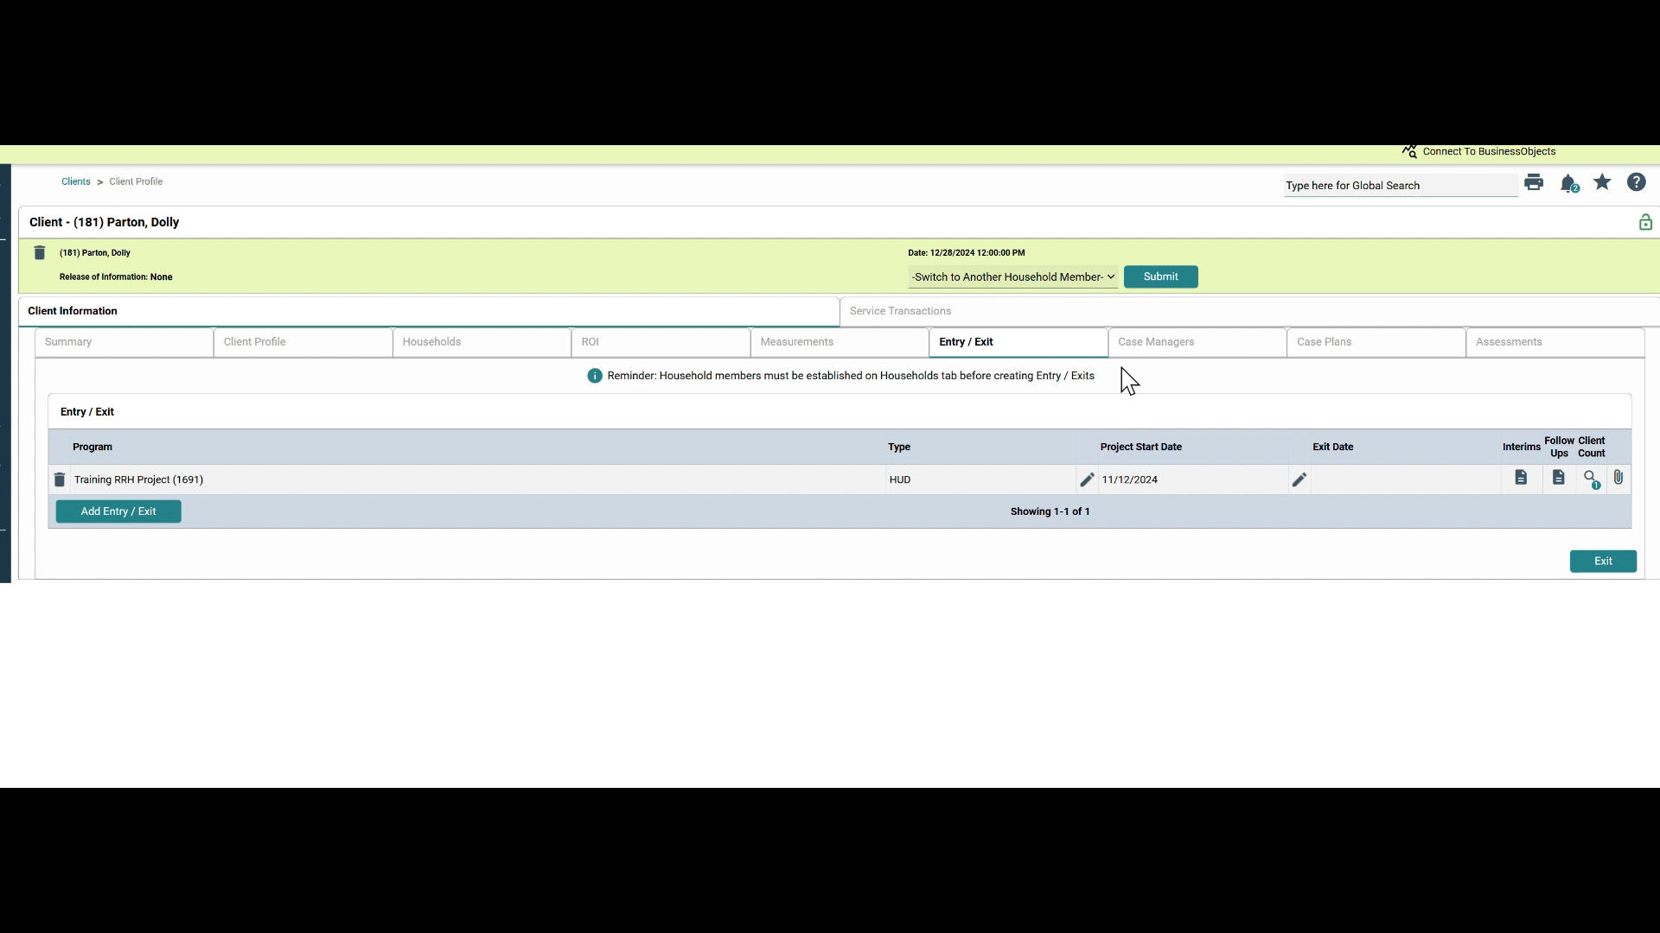
Housing Move-in Date

Slide 18
Housing Move-in Date
How to document a client who vacates a housing situation
If client vacates a housing situation, and the project stops paying rental assistance, staff should exit the client from the project with a Project Exit Date and Destination.
Staff should then create a new Project Start Date in a second enrollment for the client on the same or following day.
The Prior Living Situation in the new enrollment must reflect the location where the client slept the night before the new Project Start Date.
A new HMID will be recorded once a new housing unit is secured.

Slide 19
Housing Move-in Date
Housed Clients transferring from one PH project to another
If a client is transferred into a PSH, RRH, or other permanent housing project having already moved into a permanent housing unit, the client’s Project Start Date and HMID will be the same date.
The 'Housing Move-in Date' should not show the original move-in date because it's meant to show the client's status (whether they are housed or unhoused) during their enrollment.

Slide 20
Housing Move-in Date
Clients who move from one housing unit to another.
If client moves directly from one unit into another, with no days of homelessness in between, it is not necessary to exit and re-enter them.
The Client’s HMID would still accurately reflect the day they entered permanent housing within that enrollment record.

Slide 21
Date of Engagement
Purpose of the ‘Date of Engagement’
To document the date when the client first became actively ‘engaged’ by a street outreach project or night-by-night emergency shelter in the development of a plan to address their unhoused situation.

Slide 22
Date of Engagement
Data Collection Point
The Date of Engagement may be on or after the ‘Project Start Date’.
If the client becomes engaged while enrolled in project, ‘The Date of Engagement’ must be on or prior to the ‘Project Exit Date’.
Only one ‘Date of Engagement’ is allowed between Project Start and Exit.
If relationship with client while enrolled in project does not result in a deliberate client assessment or start of a case plan before project exit, ‘The Date of Engagement’ should be left blank.

Slide 23
Date of Engagement
Data Collection for Returning Clients
If Client returns after having exited a project, a new ‘Project Start Date’ and a new ‘Date of Engagement’ is be established once the criteria for “engagement” has been met.

Slide 24
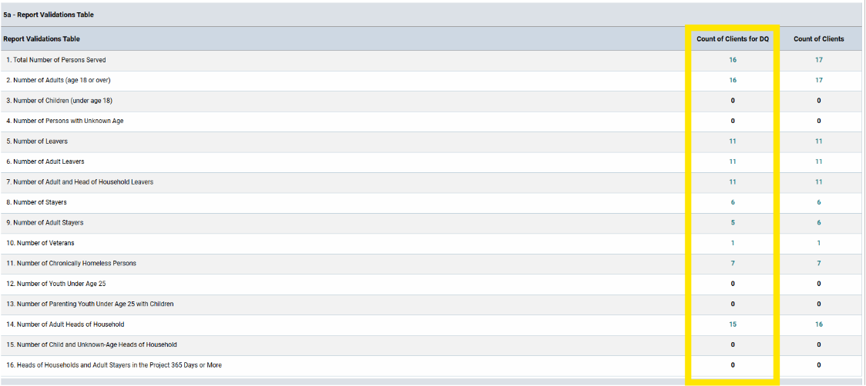
Date of Engagement
Data Quality
Reporting on data quality for street outreach projects is limited to clients with ‘Date of Engagement’
Clients without a ‘Date of Engagement' will not show on the Data Quality Report Validation Table from section 5A of the CoC APR

Slide 25
Additional Resources
Project Start Date, HMID & Date of Engagement
Project Start Date vs Housing Move-In Date
HMIS Workflow - Adding a Housing Move-In Date
HMIS Client Entry-Interim-Exit Workflow
November 2024 HMIS Refresher Training - Housing Move-in Date, Relationship to Head of Household, and Enrollment CoC Code

