Slide 1
HUD HMIS Data Standards Manual Overview

Slide 2
Outline
Introduction
HUD Data Standards & Community Services
Navigating the Manual
Universal Data Elements
Program Specific Data Elements
Federal Partner Program Data Elements

Slide 3
Background
HMIS is the information system designated by a local Continuum of Care (CoC) to comply with the requirements of CoC Program interim rule 24 CFR 578. A locally implemented data system used record and analyze client, service, and housing data for individuals and families who are experiencing homelessness or at-risk of homelessness.

Slide 4
Background
HUD through the office of Special Needs partners w other federal agencies to establish the requirements for HMIS.
Ensures that there is a comprehensive data response to the congressional mandate to report annually on national homelessness.
Used by federal partners to report on programs and performance and benchmarking effort to end homelessness.
First published by HUD in 2004. HUD, in collaboration with its federal partners, has continued to update the HMIS Data Standards thereafter.

Slide 5
Function of HMIS
Collects common data elements from people being served in projects across agencies and CoC.
Create an unduplicated count of persons experiencing homelessness
Report on the persons being served and the outcomes of a project

Slide 6
Purpose of the HUD Data Standards
Helps describe data elements and provides guidance for answering questions in HMIS.
How standards are interpreted can impact results in HMIS and reporting
Important to understand nuances within the standards. Not always clear based on data element itself.

Slide 7
HUD EXCHANGE
https://www.hudexchange.info/resource/3824/hmis-data-dictionary/

Slide 8
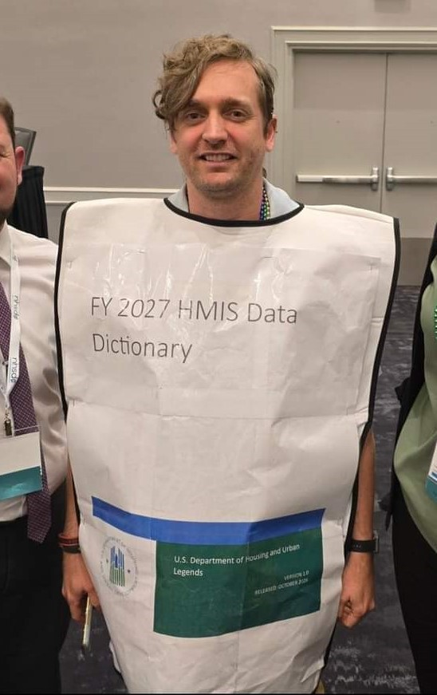
HUD Data Standards Manual
The “HMIS Bible”
FY24 version 167 pages long
Not as Scary as it seems
Not meant to memorize, but important to know how to navigate to find answers

Slide 9
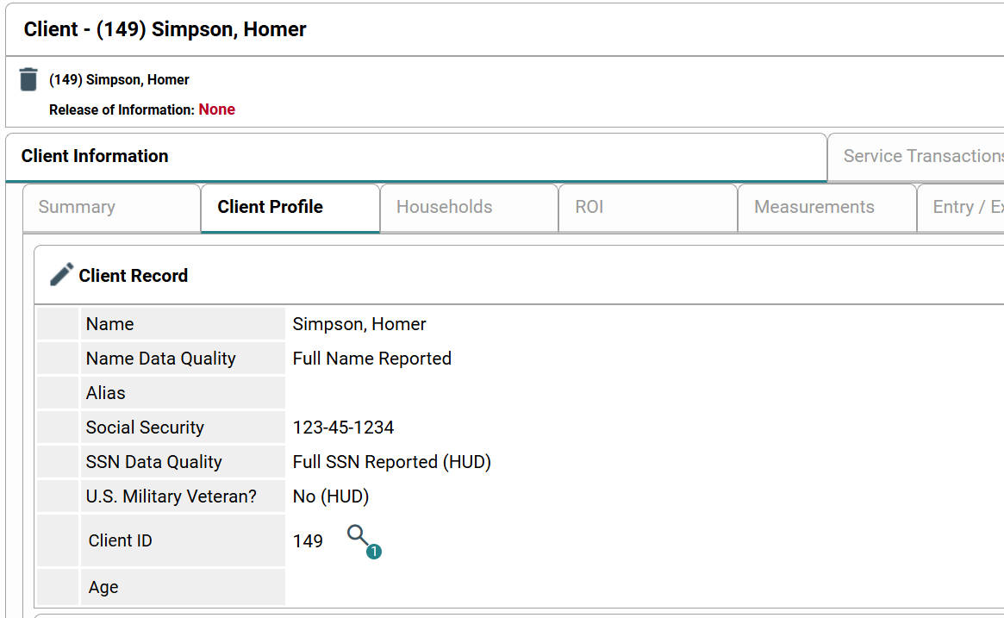
HUD Data Standards In Community Services
Appear as questions
Assessments in Community Services include data elements required for a specific project.

Slide 10
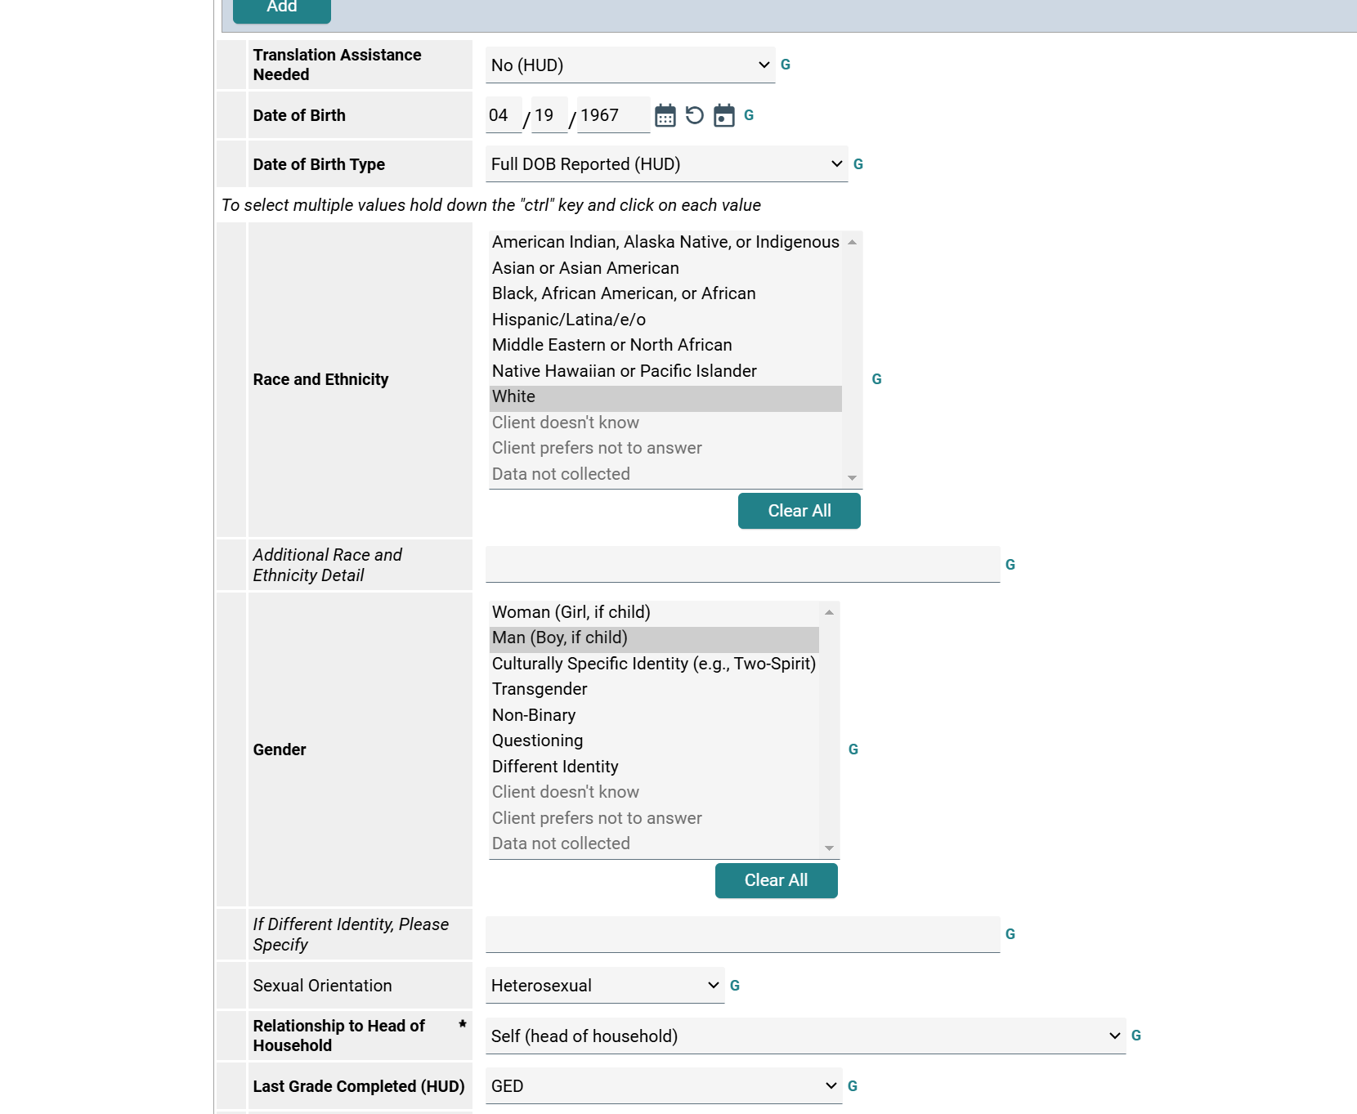
HUD Data Standards In Community Services

Slide 11
Data Element Structure
Every data element required by HUD and Federal partners stored within an HMIS is specified in this document.
Each Project Descriptor Data Element, Universal Data Element, and Common Program Specific Data element in the HUD Data Standards Manual includes the following information.

Slide 12
Data Element Structure
Rationale – Provides a basic explanation for data collection for the element and describes how the data are used in national or local reporting
Data Collection Instruction – Provides instructions for data collection and entry. Each data element includes Who the data is collected about. Funder: Component-Program requiring the data to be collected, project types required to collect this data, and the Data Collection Stage.

Slide 13
Data Element Structure
Data Collected About – The universe of client(s) for whom an element response is required (e.g., all clients, Head of Household, adults)
Funder: Component- Program – Federal department, the program, and the program component which requires the collection of the element
Project Type Applicability – The HMIS project type(s) required to collect and report the data element

Slide 14
Data Element Structure
Collection Point – The point(s) at which the data must be able to be collected in an HMIS.
Record Creation
Project Start
Occurrence Point/Update
Annual Assessment
Project Exit

Slide 15
Response Descriptions
Field Name – The names assigned to the element fields
Response Category/ Data Type – All response options associated with the field and their data type
Description – A brief explanation of the response option.
Client Doesn’t Know
Client Prefers not to Answer
Data Not Collected

Slide 16
Universal Data Elements
Required to be collected by all projects participating in HMIS, regardless of funding source.
The basis for producing unduplicated estimates of the number of people experiencing homelessness.

Slide 17
Universal Project Stay Elements (One or More Value(s) Per Client, One Value Per Project Stay)
Universal Identifier Elements (One and Only One per Client Record)
3.01 Name
3.02 Social Security Number
3.03 Date of Birth
3.04 Race and Ethnicity
3.06 Gender
3.07 Veteran Status
3.08 Disabling Condition
3.10 Project Start Date
3.11 Project Exit Date
3.12 Destination
3.15 Relationship to Head of Household
3.16 Enrollment CoC
3.20 Housing Move-In Date
3.917 Prior Living Situation

Slide 18
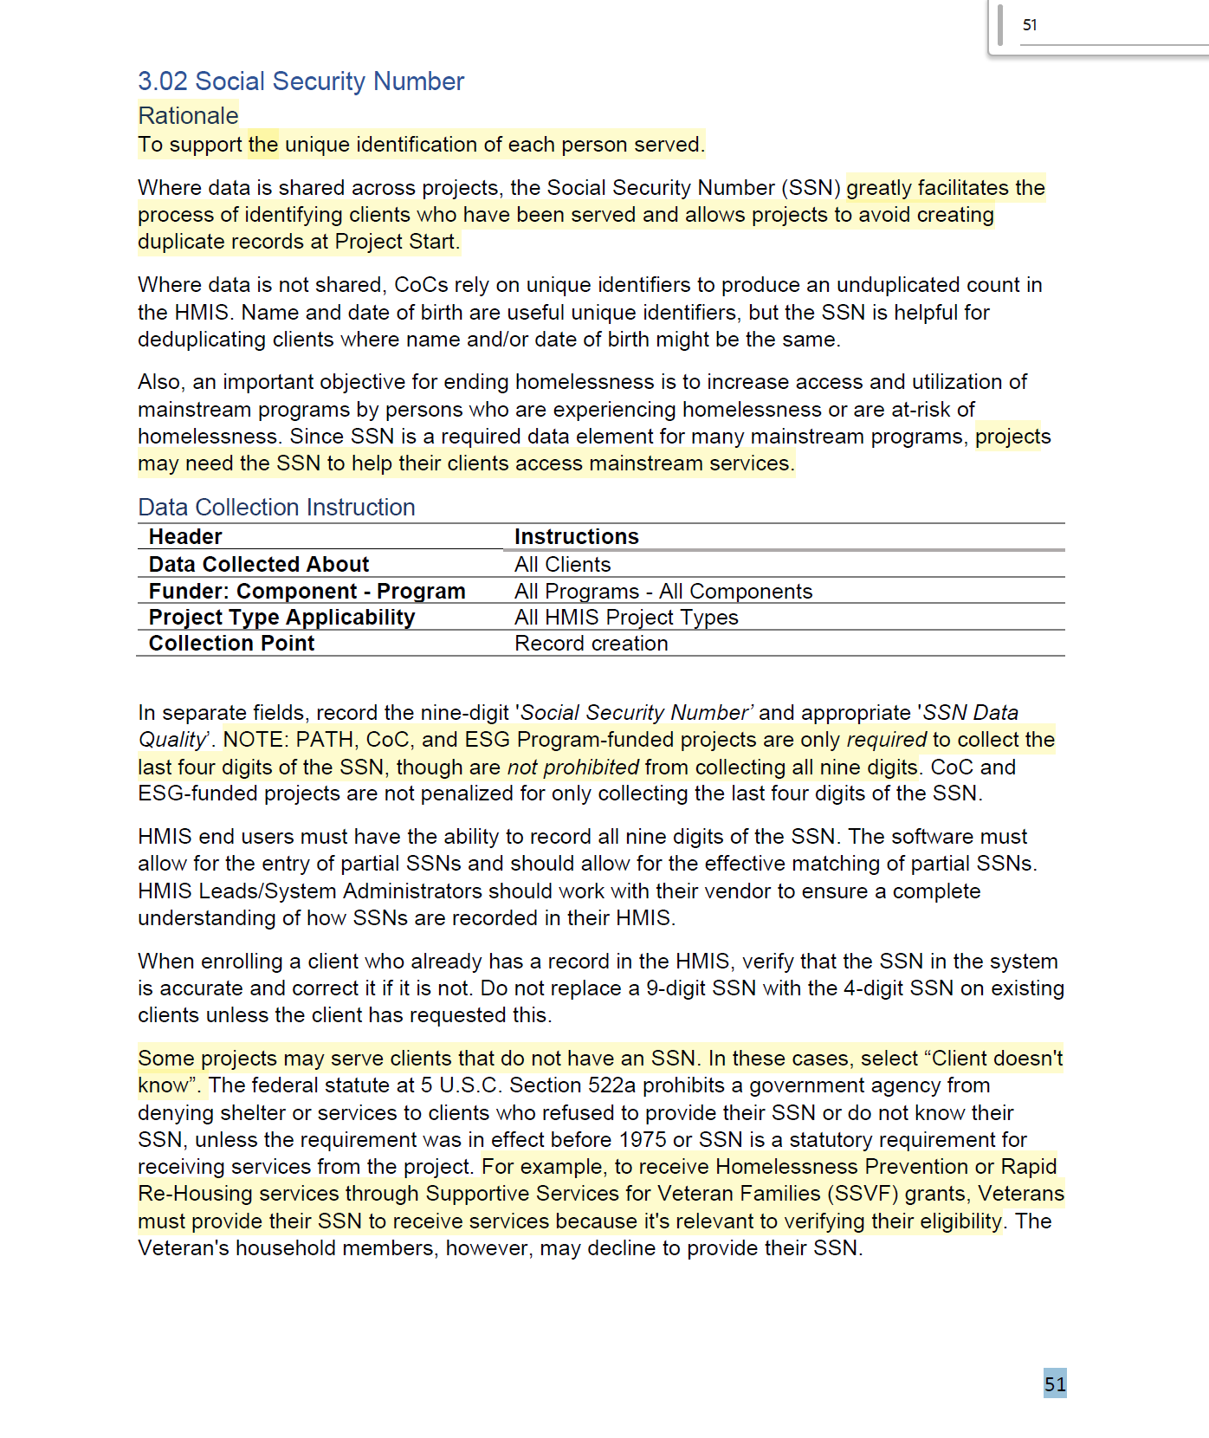

Slide 19
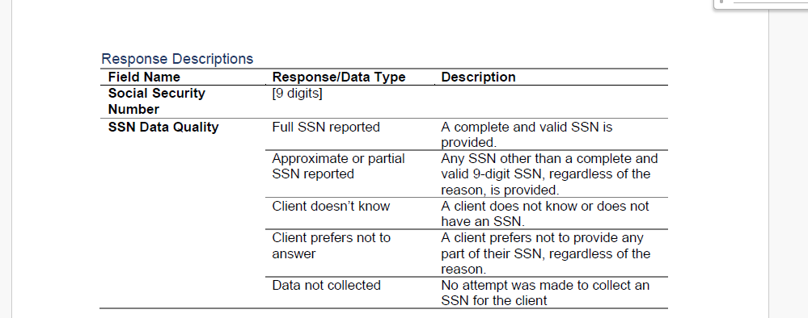

Slide 20
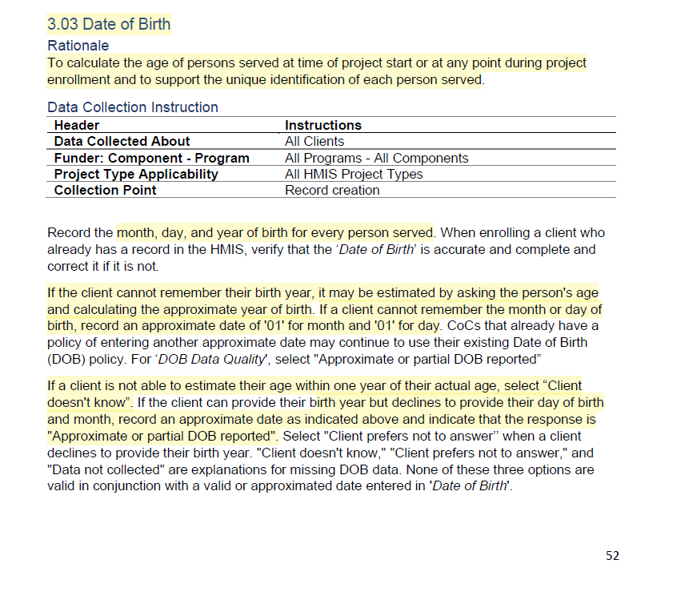

Slide 21
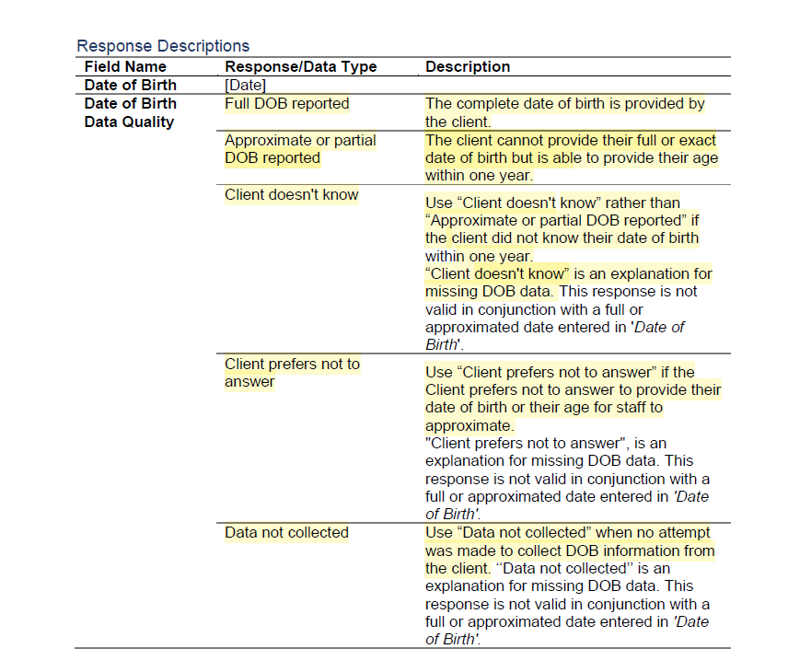

Slide 22
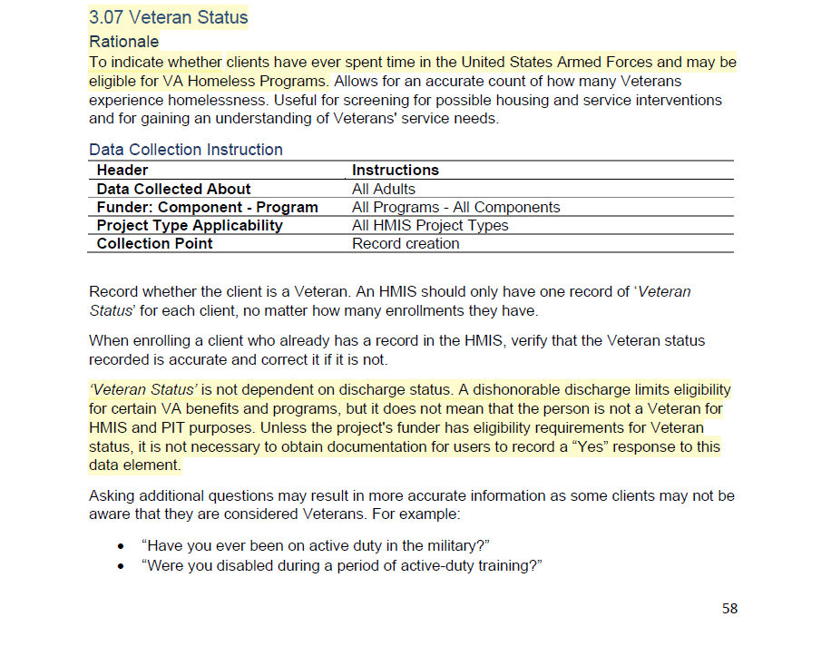

Slide 23
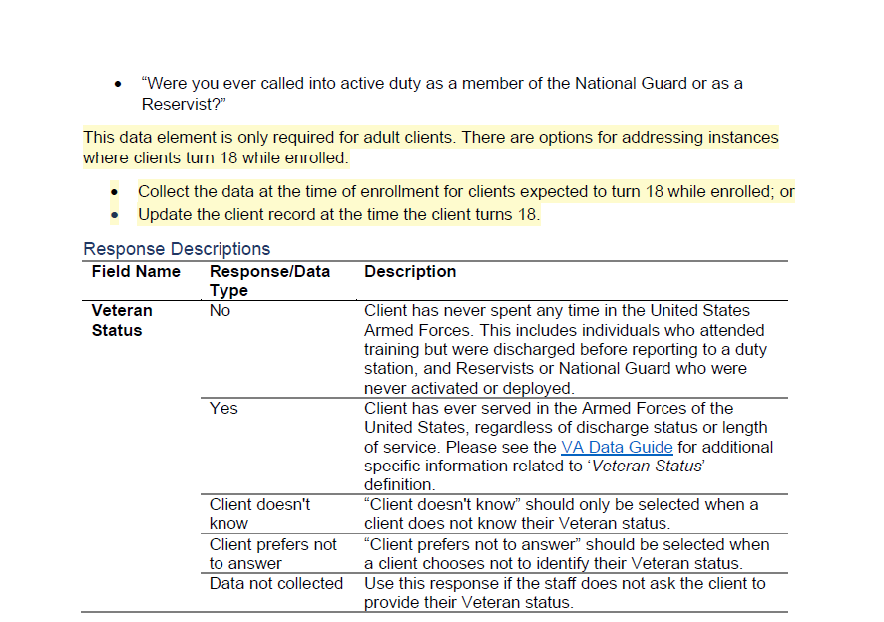

Slide 24
Program Specific Data Elements
Elements that are required by at least one of the HMIS Federal Partner programs
Some of the program specific data elements are collected across most Federal Partner programs. These are called “Common” Program Specific Data Elements

Slide 25
Program Specific Data Elements
4.02 Income and Sources
4.03 Non-Cash Benefits
4.04 Health Insurance
4.05 Physical Disability
4.06 Developmental Disability
4.07 Chronic Health Condition
4.08 HIV/AIDS
4.09 Mental Health Disorder
4.10 Substance Use Disorder
4.11 Domestic Violence
4.12 Current Living Situation
4.13 Date of Engagement
4.14 Bed-Night Date
4.19 Coordinated Entry Assessment
4.20 Coordinated Entry Event

Slide 26
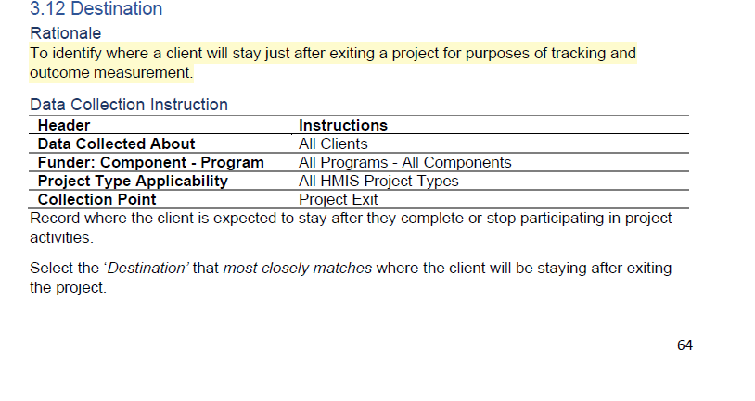

Slide 27
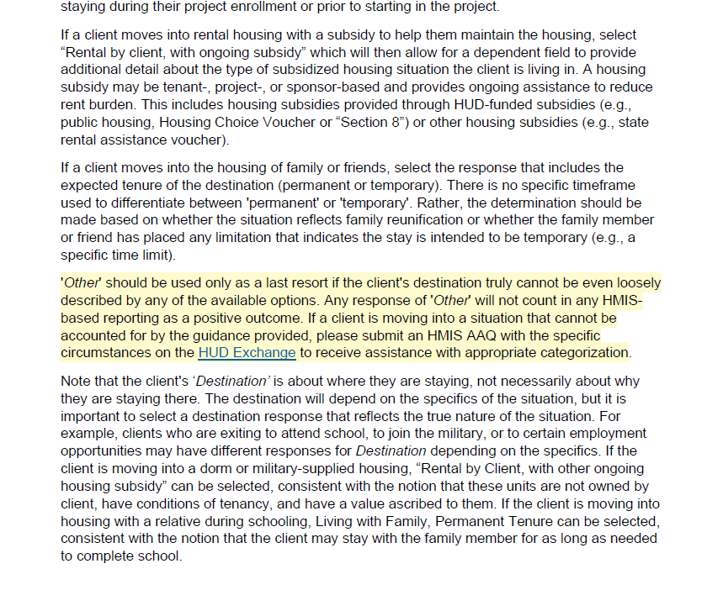

Slide 28
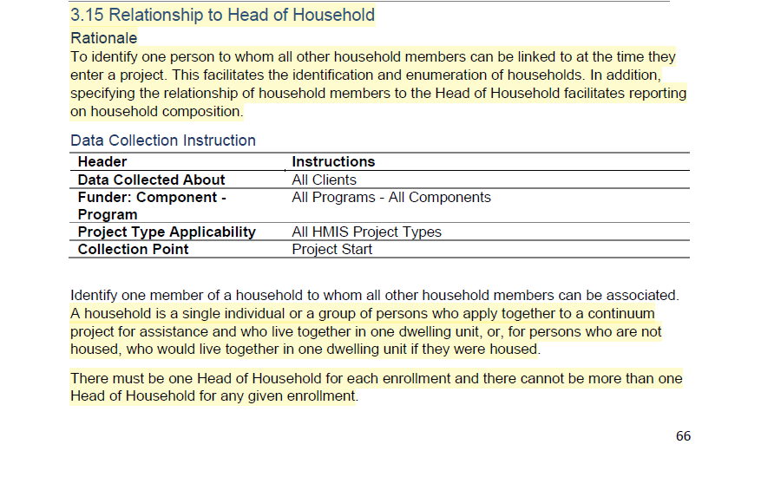

Slide 30
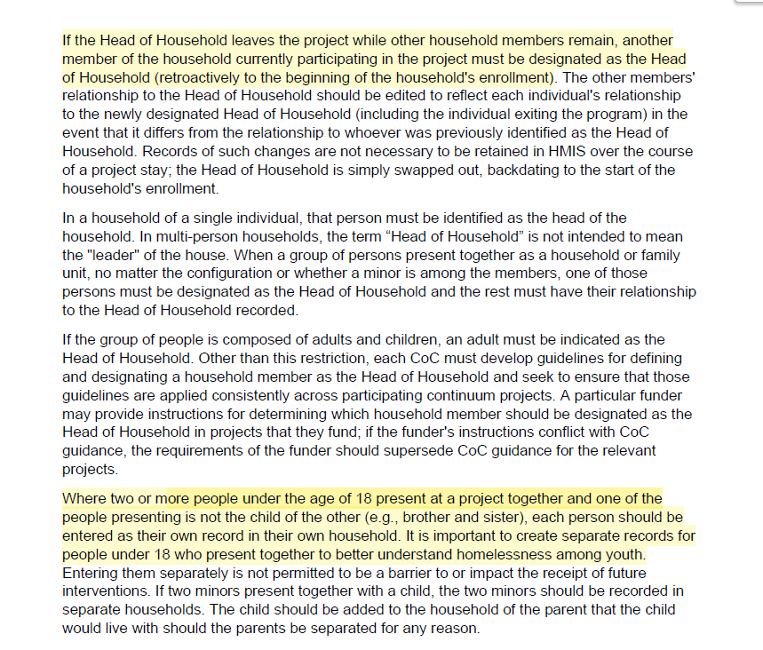

Slide 32
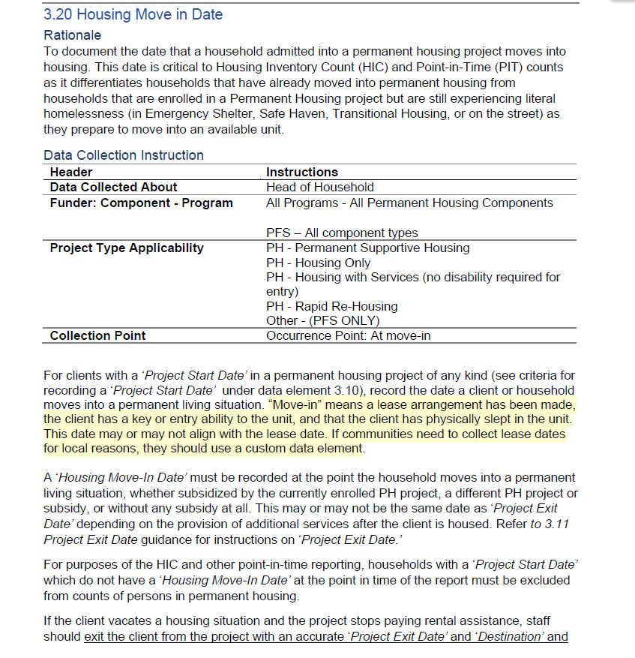

Slide 33
Federal Partner Program Specific Data Elements
Additional guidance about data collection rationale and specific project setup and data collection instructions can be found in the federal partner program HMIS Manuals.
The Data Standards Manual contains only general information about the element and basic minimum data collection instructions

Slide 34
Federal Partner Program HMIS Manual
Continuum of Care (CoC)
Housing Opportunity People With Aids (HOPWA)
Projects for Assistance in Transition from Homelessness (PATH)
Runaway Homeless Youth (RHY)
Veterans Affairs (VA)
Emergency Solutions Grant

